Slide 1
Achieving Better Long-term PCI Outcomes: secondary prevention for your patients
Team Lead Dr. Timir Paul MD, PhD, FSCAI; Co-Chair: Dr. Debabrata Mukherjee, MD, MSCAI
Evelyn Baram-Clothier, PhG, JD; Shahriar Dadkah, MD, FSCAI; Carey Kimmelstiel, MD, MSCAI; Faisal Latif , MD, FSCAI; Adedotun Ogunsua, MD, MPH; Hany Ragy, MD, FSCAI; Talla Rousan, MD, FSCAI; Pradyumna Tummala, MD, FSCAI

Slide 2
Achieving Better Long-term PCI Outcomes: secondary prevention for your patients
Giving patients a better understanding of modifiable risk factors for ASCVD
Empowering patients to reduce their individual risk
Improving communication between providers to provide guidance and better follow-up

Slide 3
Your Interventional Cardiology Patients
Whether treated for an acute coronary syndrome (ACS) or chronic coronary disease (CCD)
Need for coronary intervention creates a heightened awareness of CV mortality risk
Unique window of opportunity for you to:
Provide hope for a healthy future
Motivate patients for lifestyle change
Assess cardiovascular risk factors
Initiate optimal guideline-directed medical therapy, whether directly or through the cardiovascular care team

Slide 4
Gaps in Care
2013 ACC/AHA guidelines had a modest or negative impact on:
Patients who received lipid panels
LDL-C levels
Statin use
High intensity statin use, even in patients with ASCVD
Gaps in appropriate statin use remain among younger patients, women, and those with noncoronary ASCVD.
Only 20.2% of patients receive lifestyle counseling, and the rate decreased from 2006 to 2016
Recent studies reported that only 35.7% of PCI patients had a lipid panel within 6 months and half never did at any point during hospitalization
Levintow SN, et al. Clin Epidemiol. 2020;12:835-845.
Okerson T, et al. J Am Heart Assoc. 2017;6(3):e004909.
Pokharel Y et al. JAMA Cardiol. 2017;2(4):361-369.
Nelson AJ, et al. J Am Coll Cardiol. 2022;79(18):1802-1813.
Mufarreh A, et al. JAMA Netw Open. 2023;6(1):e2251156.
Johnson, MT, et al. Journal of Clinical Lipidology, 13(3), 486-492.
Gupta, S et al. American Heart Journal, 217, 57-68.

Slide 5
9 Modifiable Risk Factors of Cardiovascular Diseases
Dyslipidemia/hypercholesterolemia
Hypertension
Diabetes mellitus
Cigarette smoking or second hand smoking
Overweight/Obesity
Unhealthy diet / added sugar
Physical inactivity
Lack of Sleep
Stress
Insert image of Modifiable Risk Factors Checklist

Slide 6
Dyslipidemia/hypercholesterolemia
Evidence that serum cholesterol is causal for ASCVD is well-established and comes from animal studies, epidemiological studies, prospective cohort studies, RCTs, as well as knowledge of genetic forms of hypercholesterolemia.
Patients with severe hypercholesterolemia (LDL-C ≥190 mg/dL [≥4.9 mmol/L]) and patients with known ASCVD should be on high-intensity statins to reduce LDL-C by ≥50%
Non-statin therapies should be considered in addition to statins for patients with very high risk ASCVD and LDL-C >70mg/dL (1.8 mmol/L)
In very high-risk ASCVD a lower LDL-C threshold of LDL-C ≥ 55 mg/dL is recommended (2022 ACC Expert Consensus Decision Pathway)
Grundy SM et al., Circulation 2018; 139 (25): e1082-e1143.
Lloyd-Jones DM et al. J Am Coll Cardiol. 2022 Oct, 80 (14) 1366–1418)

Slide 7
Hypertension Goal and Non-pharmacological Treatment
Blood pressure goal < 130/80 with or without comorbidities
Non-pharmacological therapy for elevated BP (120-129/<80) and stage I hypertension (BP 130-139/80-89 mm hg) (Class I)
Weight loss who are overweight or obese
A heart-healthy diet, such as the DASH (Dietary Approaches to Stop Hypertension) diet
Sodium reduction; Optimal goal is <1500 mg/day
Potassium supplementation
Increased physical activity
Drink no more than 2 and 1 standard drinks per day for men and women respectively
Non-Pharmacological and Pharmacologic Rx (class I)
Stage I hypertension and clinical atherosclerotic cardiovascular disease (ASCVD) or 10 yr ASCVD risk > 10 %
Stage II hypertension BP > 140/90
P.K. Whelton et al. 2017 ACC/AHA hypertension guidelines

Slide 8
Diabetes
Fasting blood glucose >= 126 mg/dl (7.0 mmol/L) or A1C >6.5% is diagnostic for diabetes
A1C goal for adults is <7% (53 mmol/mol) without significant hypoglycemia.
Patients with diabetes and established ASCVD, target an LDL cholesterol reduction of 50% from baseline and an LDL cholesterol goal of <55 mg/dL.
Patients with diabetes should be on moderate to high intensity statin therapy.
Elsayed NA et al, standards of care in diabetes 2023, Diabetes Care 2023;46(Suppl. 1):S5–S9

Slide 9
Smoking Cessation
Tobacco kills up to half of its users.
All forms of tobacco are harmful, there is no safe method or level of exposure.
E-cigarettes (ENDS) are harmful, most contain highly addictive nicotine.
There is increasing use of water pipe (Hookah) smoking and adverse cardiovascular effects.
ENDS are mostly produced by the tobacco industry aiming at more nicotine addicts specially among younger users who may perceive it wrongly as less dangerous than conventional cigarettes.
Secondhand smoke inhalation is harmful and 100% smoke free environments are the only proven way to protect health.
Patients should receive dedicated smoking cessation counseling services and treatment when indicated both inpatient and outpatient settings.
WHO: https://www.who.int/news-room/fact-sheets/detail/tobacco
AHA: https://professional.heart.org/en/science-news/water-pipe-hookah-smoking-and-cardiovascular-disease-risk/Commentary

Slide 10
Overweight and Obesity
Obesity often associated with hypertension, dyslipidemia, diabetes, and other comorbidities that all contribute to higher risk of ASCVD
Obesity negatively affects cardiac structure and function
Individual differences in regional body fat distribution, as well as cardiorespiratory fitness may be as important as overall BMI
Overweight and obesity in young people particularly associated with higher risk of coronary artery disease, STEMI, and NSTEMI
Weight loss in severely and morbidly obese patients reduces risk of CVD and heart failure
Powell-Wiley TM, et al. Circulation. 2021;143:e984–e1010
Csige I, et al. J Diabetes Res. 2018 Nov 4;2018:3407306.
Said S, et al. Curr Vasc Pharmacol. 2016;14(5):415-425. PMID: 27456105.

Slide 11
Heart Healthy Living is all about Prevention
Quit smoking, avoid secondhand smoking
Be active (at least 30 min moderate CV exercise 5 days a week)
Low intake of saturated and trans fat
Limit red and processed meat, sweets, sugar beverages
Limit alcohol intake
No more than 2 grams salt daily
Sleep 7-9 hours daily

Slide 12
Avoiding Added Sugar
Added sugars are a likely dietary culprit leading to CHD and mortality. Over a few weeks, it produced numerous abnormalities including elevated insulin levels and insulin resistance. A low diet reversed all of these metabolic defects clinically.
There is research evidence that dietary sucrose, not fat, is the main driver of metabolic inflammation accelerating severe atherosclerosis.
Added Sugars and Cardiovascular Disease Risk in Children: A Scientific Statement From the American Heart Association
Strong evidence supports the association of added sugars with increased CV disease risk in children through increased adiposity, and dyslipidemia making this an important public health target.
Canadian National Nutrition Survey on Health 2022
The association from added sugars and all-cause mortality was significant
US National Health and Nutrition Survey 2021
Higher Sugar-Sweetened Beverages intake were associated with higher risks of all-cause mortality and heart disease mortality
Perazza, L. et. al. Atherosclerosis Jul;304:9-21. 2020

Slide 13
Physical Inactivity
Individuals who engage in high levels of physical activity have a 24% lower risk of developing CVD compared to those who were physically inactive, and a 20% reduced risk of coronary heart disease.
Physical activity has been shown to improve several CVD risk factors, including blood pressure, cholesterol levels, obesity, and insulin sensitivity.
Adults should engage in at least 150 minutes of moderate-intensity aerobic exercise or 75 minutes of vigorous-intensity aerobic exercise per week to improve their cardiovascular health (Class I, Level B-NR)
Li, J, et al. International Journal of Environmental Research and Public Health, 13(9), 1-15.
Zheng, H, et al. European Journal of Epidemiology, 34(10), 923-936.
Arnett et al. Journal of the American College of Cardiology, 74(10), e177-e232.
Whayne TF, et al. Curr Vasc Pharmacol. 2016;14(5):458-465. PMID: 27456103.

Slide 14
Healthy Sleep
American Heart Association’s check list to measure cardiovascular health (CV) health is updated to add healthy sleep as essential for optimal CV health.
The new sleep metric suggests 7-9 hours of sleep daily for adults for optimal CV health and more for children.
AHA 2022: https://newsroom.heart.org/news/american-heart-association-adds-sleep-to-cardiovascular-health-checklist

Slide 15
Stress
Stress has a moderate association with ASCVD in the general population, but strong associations have been observed in high-risk populations
Stressors linked to ASCVD include:
stress at work
social isolation
marital problems
caring for a sick spouse or child at home
death of a close person
2021 ESC Guidelines on CVP Prevention state that ASCVD patients with stress should be considered for referral to psychotherapeutic stress management to improve CV outcomes and reduce stress symptoms (Class IIA, Level B).
Kivimäki M, Steptoe A. Nat Rev Cardiol. 2018;15(4):215-229.
Visserin FLJ, et al. Eur Heart J. 2021;42(34):3227–3337.

Slide 16
Post Cardiovascular Events

Slide 17
Cardiac rehabilitation (CR)
CR is a class I recommendation for patients with HFrEF, ischemic heart disease, post percutaneous coronary intervention, coronary artery bypass graft surgery.
Patients benefit from participation in a CR program that incorporates supervised exercise into a comprehensive secondary prevention program.
Earlier enrollment in, and insurance of adherence of CR may be associated with better patient outcomes.
Every day that passes after hospital discharge without starting CR is associated with 1% decrease in participation.
Thomas et al. JACC 2018 Apr 24; 71(16):1814-1837
Fihn et al. JACC. 2012 Dec 18;60(24):e44-e164

Slide 18
Exercise Counseling
Aerobic exercise is the gold standard of CR
Training sessions should be 3-5 times a week and each session should last 20-60 minutes (session includes warm up, main exercise, and cool down
Exercises modalities include walking, jogging, cycling or rowing.
Goal is to achieve 50-80% of the exercise capacity achieved during stress testing.

Slide 19
Stress Management
Be active
Get enough sleep
Meditate
Try Yoga
Listen to music

Slide 20
Next Steps
Provide patients with accessible, evidence-based information
Set achievable goals with patients
Initiate discussion of barriers patients face in risk factor mitigation and adherence to medication
Facilitate communication between providers during follow-up

Slide 21
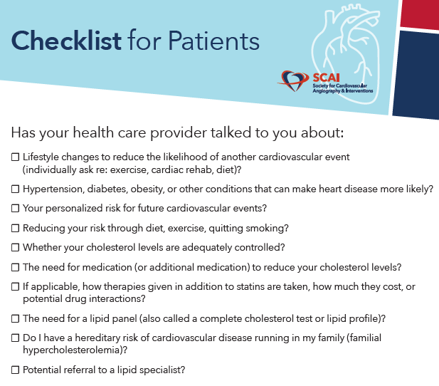
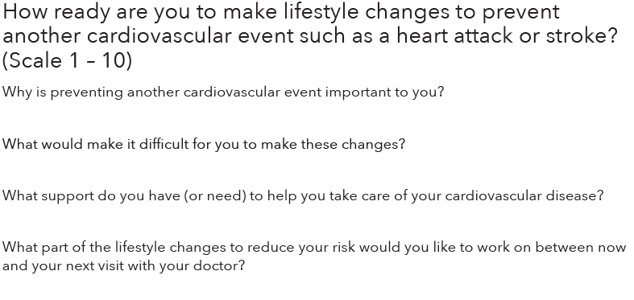
Clinician-Patient Discussion

