Slide 1
Optimal Management of Lipids for Secondary Prevention
Team Lead Dr. Timir Paul MD, PhD, FSCAI; Co-Chair: Dr. Debabrata Mukherjee, MD, MSCAI
Evelyn Baram-Clothier, PhG, JD; Shahriar Dadkah, MD, FSCAI; Faisal Latif , MD, FSCAI; Hany Ragy, MD, FSCAI; Talla Rousan, MD, FSCAI; Pradyumna Tummala, MD, FSCAI
Updated August 8, 2024

Slide 2
Optimal Management of Lipids for Secondary Prevention
Recognizing system-level gaps in the care of our PCI patients
Documenting and communicating across the care team to ensure that our patients receive optimal guideline directed lipid-lowering therapy for secondary prevention
Empowering patients with knowledge necessary to make decisions about setting and achieving their target lipid levels

Slide 3
Gaps in CVD Risk Assessment
Only 50% of patients undergoing PCI had a lipid profile documented at any point during their hospitalization.
Only 35.7% of PCI patients had a lipid panel within 6 months of the intervention.
Many PCI patients do not receive guideline-directed medical therapy, such as antiplatelet therapy and statins.
Tailoring therapy based on individual risk factors can improve outcomes and reduce costs.
Minorities and underserved populations have a higher burden of CVD and are less likely to receive guideline-directed secondary prevention therapies.
Gupta, S et al. American Heart Journal 2019
Johnson, MT et al. Journal of Clinical Lipidology 2019
Alasnag, M et al. BMC Cardiovascular Disorders, 2020
Mukherjee, D et al. Circulation, 2004
Toma et al, Journal of Clinical Nursing, 2019
Amin et al, Circulation, 2020
Kaufman et al, Current cardiology reports, 2021
Notes:
Gupta, S., Iribarne, A., Anderson, H. V., Weintraub, W. S., Samadashvili, Z., Ailawadi, G., ... & Smith, D. E. (2019). Frequency and practice-level variation in inappropriate and nonrecommended prasugrel prescribing: Insights from the NCDR PINNACLE registry. American Heart Journal, 217, 57-68.
Johnson, M. T., Wilkins, J. T., Giuseffi, J., & Kripalani, S. (2019). Utilization of lipid testing and achievement of low-density lipoprotein cholesterol targets in a percutaneous coronary intervention population. Journal of Clinical Lipidology, 13(3), 486-492.
Alasnag, M., Al-Shammeri, O., Al-Suwaidi, J., & Al-Mulla, A. (2020). Evidence-based therapy prescription and adherence after percutaneous coronary intervention in patients with acute coronary syndrome. BMC Cardiovascular Disorders, 20(1), 1-8.
Mukherjee D, Fang J, Chetcuti S, Moscucci M, Kline-Rogers E, Eagle KA (2004). Impact of combination evidence-based medical therapy on mortality in patients with acute coronary syndromes. Circulation. 2004 Feb 17;109(6):745-9. PMID: 14970110.
Toma, A., Bresnahan, D. R., Stefanescu, A., & Bresnahan, J. F. (2019). Medication adherence after percutaneous coronary intervention: An integrative review. Journal of Clinical Nursing, 28(9-10), 1617-1632.
Amin, N. P., Martin, S. S., Blaha, M. J., & Nasir, K. (2020). Tailored versus population-level implementation of cardiovascular disease prevention guidelines. Circulation, 141(24), 2023-2026.
Kaufman, B. G., Spivack, B. S., & Stearns, S. C. (2021). Health disparities and the burden of cardiovascular disease in the United States. Current cardiology reports, 23(3), 1-10.

Slide 4
Pharmacological Options for Dyslipidemia
Statins
Ezetimibe
PCSK9 inhibitor (PCSK9i) monoclonal antibodies
Inclisiran (siRNA directed to PCSK9)
Omega-3 fatty acids / Icosapent ethyl
Bempedoic acid
Fenofibrates (for triglycerides)
LDL apheresis

Slide 5
Lipid Goals in ASCVD
In very high-risk ASCVD a lower LDL-C threshold of LDL-C of 55 mg/dL is recommended (2022 ACC Expert Consensus Decision Pathway)
Both LDL-C reduction by ≥ 50% from baseline and an LDL-C goal of <55 mg/dl is recommended (ESC/EAS 2019)
Patients with diabetes and established ASCVD, target an LDL cholesterol reduction of 50% from baseline and an LDL cholesterol goal of <55 mg/dL. (ADA 2023)
Lloyd-Jones DM et al. J Am Coll Cardiol. 2022 Oct, 80 (14) 1366–1418) Mach F et al. 2019, Eur. Heart J. 41 (2020) 111–188. Elsayed NA et al, Diabetes Care 2023;46(Suppl. 1):S5–S9

Slide 6
Very High Risk for Future ASCVD events
Major ASCVD Events
Recent ACS (within the past 12 months)
History of MI (other than recent ACS event)
History of Ischemic stroke
Symptomatic PAD (history of claudication with ABI <0.85, or previous revascularization of amputation)
*Very high risk includes a history of multiple major ASCVD events or 1 major event with multiple high-risk conditions
High-Risk Conditions
Age ≥ 65 years
Heterozygous familial hypercholesterolemia
History of prior CABG or PCI outside of the major ASCVD event(s)
Diabetes mellitus
Hypertension
CKD (eGFR 15-59mL/min/1.73 m2)
Current smoking
Persistently elevated LDL-C (LDL-C ≥100mg/dL) despite maximally tolerated statin and ezetimibe
History of congestive Heart Failure
Grundy SM et al. Circulation 2018; 139 (25)​
Notes:
Original figure above to the right for reference.

Slide 7
Achieving the Target Lipid Goal
First Line Treatment
High intensity statin therapy or maximally tolerated statin therapy (Class I)
If LDL-C ≥ 70 mg/dl while on statin, add ezetimibe to maximally tolerated statin therapy (Class IIa)
Bempedoic acid is now an option for patients with established ASCVD who are unable to take recommended statin therapy (including those not taking a statin)
As an adjunct to diet, bempedoic acid, alone or in combination with other LDL-C lowering therapies in adults with primary hyperlipidemia, including HeFH
When to add PCSK9 Inhibitor (PCSK9i) monoclonal antibodies?
In very high-risk ASCVD patients if LDL-C level remains ≥70 mg/dL or non-HDL ≥ 100 mg/dl on maximally tolerated statin and ezetimibe therapy (Class IIa)
If LDL-C ≥ 55 mg/dl while on statin in very high-risk patients, consider adding ezetimibe and/or PCSK9i to maximally tolerated statin therapy (ACC 2022 ECDP)
Patients with statin intolerance
Grundy SM et al. Circulation 2018; 139 (25)​
Mach, F et al. Eur Heart J 2020; 41(1):111-188
Lloyd-Jones et al. JACC 2022;80, (14)

Slide 8
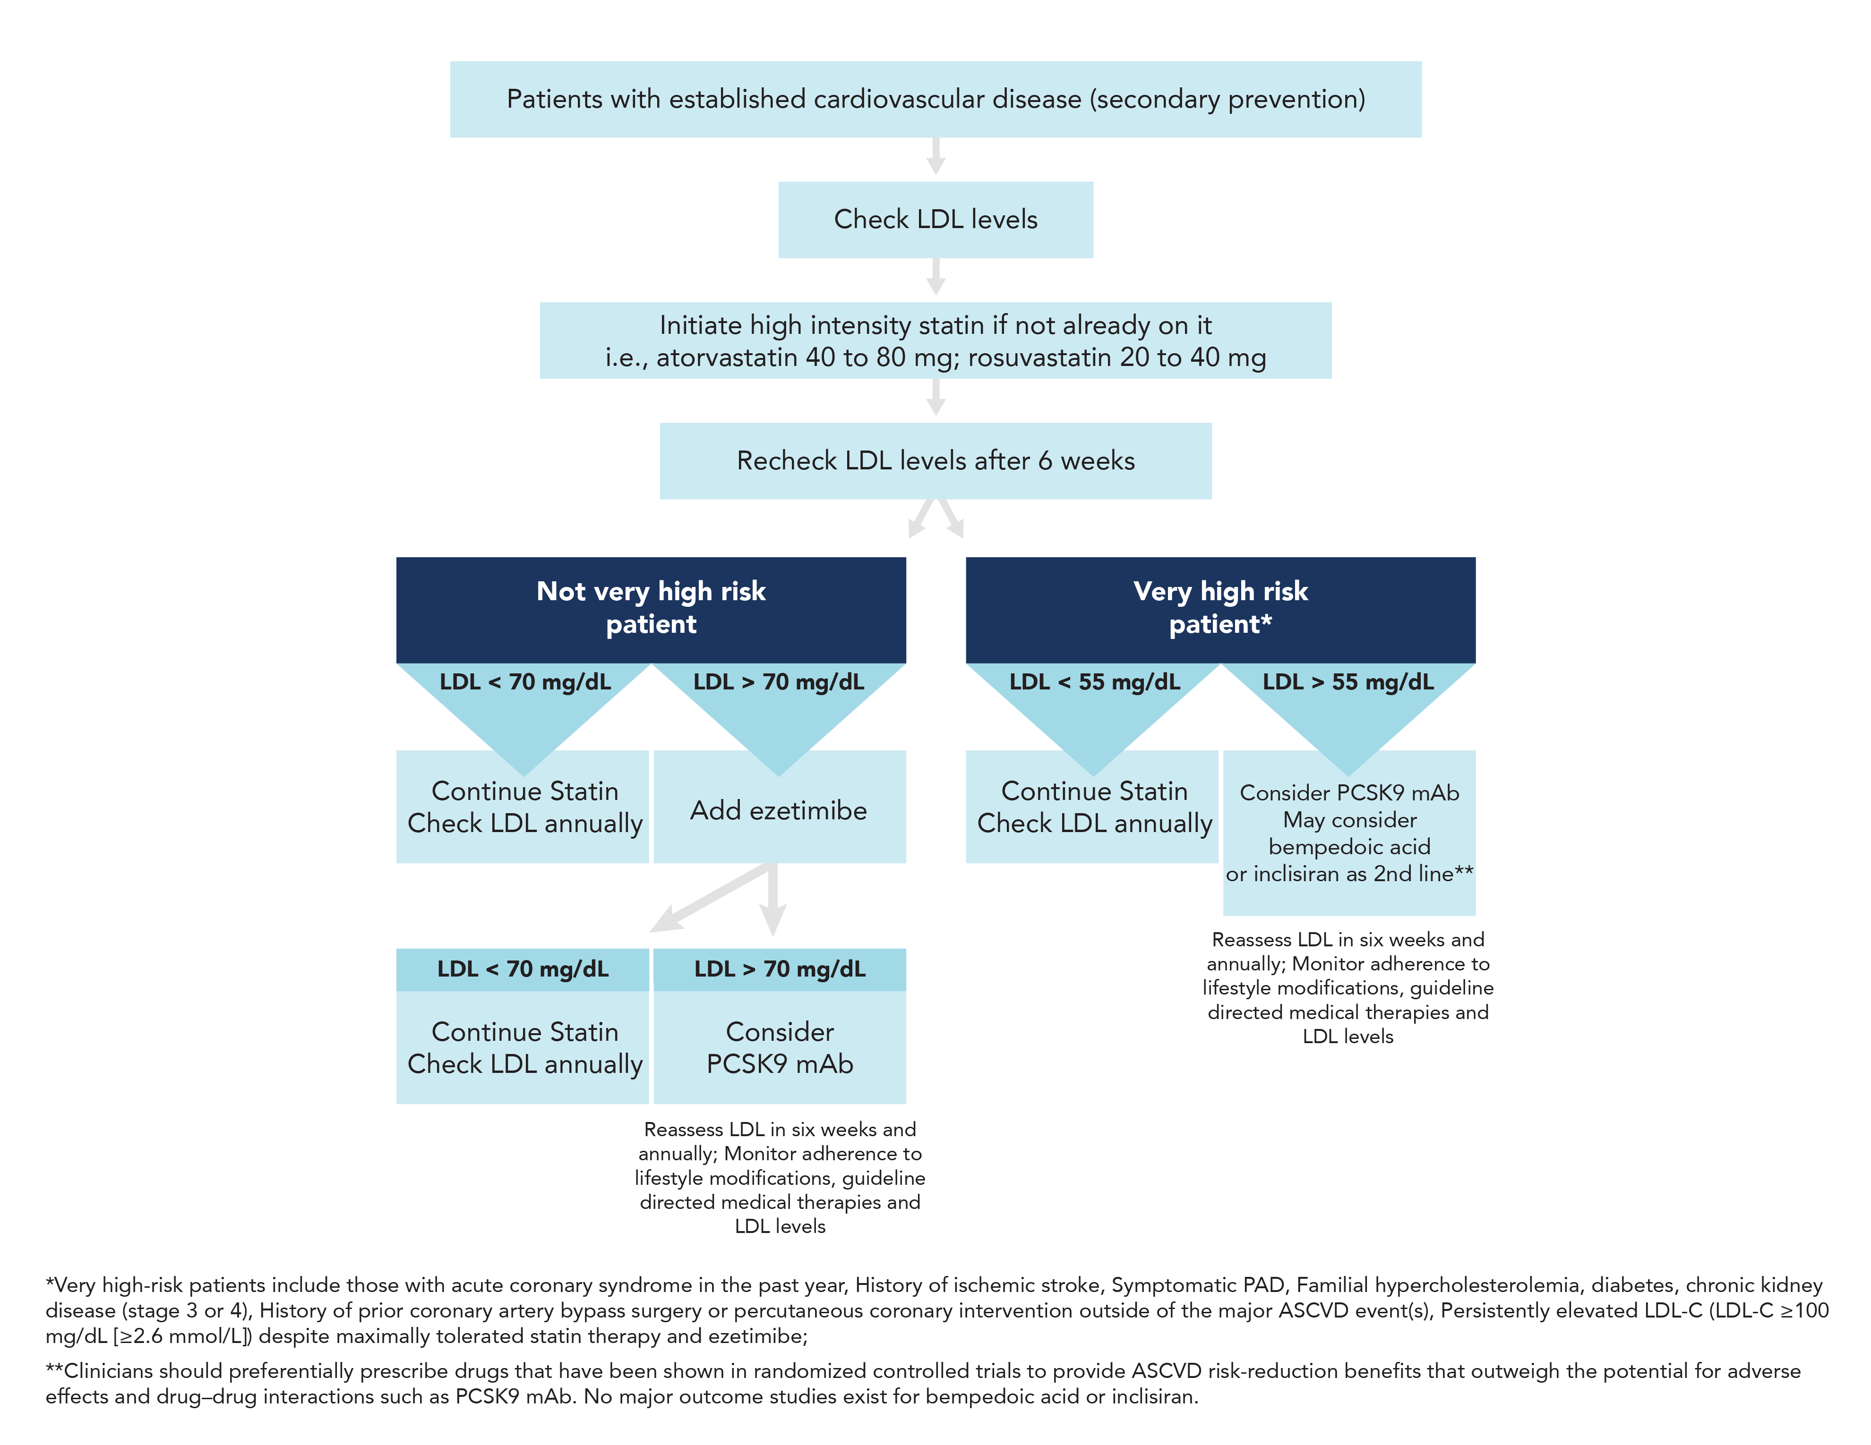
Proposed Algorithm for Lipid Lowering Medications
2022 ACC Expert Consensus Decision Pathway on the Role of Nonstatin Therapies for LDL-Cholesterol
Lowering in the Management of Atherosclerotic Cardiovascular Disease Risk

Slide 9
Statin Therapy for Patients with ASCVD
High-intensity statin therapy typically lowers LDL-C levels by ≥50%, moderate-intensity statin therapy by 30% to 49%, and low-intensity statin therapy by <30%
RCTs consistently demonstrate that statin therapy reduces the risk of major CVD events by 21-23% for each mmol/L (38.7 mg/dL) reduction in LDL-C during each year (after the first) that it is taken.
The benefits of therapy depend on an individual’s absolute risk of ischemic events and the absolute reduction in LDL-C. Lowering LDL cholesterol by 2 mmol/L (77 mg/dL) with statin therapy for 5 years would reduce absolute risk of ischemic events by 10% in patients who have had CV ischemic events (secondary prevention), by 5% in patients at increased risk for vascular events (primary prevention).
Statin therapy reduces vascular disease risk during each year of continued therapy, with persistent long-term benefits.
Grundy SM et al. Circulation 2018; 139 (25)
Collins R et al. Lancet 2016; 388: 2532–61
Notes:
(Including Coronary Artery Disease and Peripheral Vascular Disease)
Grundy SM et al. AHA/ACC/AACVPR/AAPA/ABC/ACPM/ADA/AGS/APhA/ASPC/NLA/PCNA Guideline on the Management of Blood Cholesterol:
A Report of the American College of Cardiology/American Heart Association Task Force on Clinical Practice Guidelines, Circulation 2018; 139 (25): e1082-e1143, DOI: (10.1161/CIR.0000000000000625)
Collins R et al. Interpretation of the evidence for the efficacy and safety of statin therapy Lancet 2016; 388: 2532–61 http://dx.doi.org/10.1016/S0140-6736(16)31357-5

Slide 10
Reduction in LDL Based on Daily Dose of Statin
5 mg 10 mg 20 mg 40 mg 80 mg
Pravastatin 15% 20% 24% 29% 33%
Simvastatin 23% 27% 32% 37% 42%
Atorvastatin 31% 37% 43% 49% 55%
Rosuvastatin 38% 43% 48% 53% 58%
High intensity statins
Moderate intensity statins
Other moderate intensity statins: Fluvastatin 80 mg, Lovastatin 40-80 mg, and Pitavastatin 1-4 mg daily)
Grundy SM et al. Circulation 2018; 139 (25)
Collins R et al. Lancet 2016; 388: 2532–61
Notes:
Collins R et al. Interpretation of the evidence for the efficacy and safety of statin therapy Lancet 2016; 388: 2532–61 http://dx.doi.org/10.1016/S0140-6736(16)31357-5
Grundy SM et al. AHA/ACC/AACVPR/AAPA/ABC/ACPM/ADA/AGS/APhA/ASPC/NLA/PCNA Guideline on the Management of Blood Cholesterol:
A Report of the American College of Cardiology/American Heart Association Task Force on Clinical Practice Guidelines, Circulation 2018; 139 (25): e1082-e1143, DOI: (10.1161/CIR.0000000000000625)

Slide 11
2018 Guideline: High versus Moderate Intensity Statin Therapy
Patients with ASCVD not at very high risk:
Age <75
High Intensity Statin to lower LDL-C by >50%, Class I recommendation
Moderate Intensity Statin, Class I recommendation for those who do not tolerate high intensity statin
Age >75
Initiation of moderate or high intensity statin or continuation of high intensity statin are both reasonable, Class IIa recommendation
Patients with ASCVD at very high risk:
High Intensity or Maximally Tolerated Statin is Class I recommendation
Grundy SM et al. Circulation 2018; 139 (25)​
Notes:
Grundy SM et al. AHA/ACC/AACVPR/AAPA/ABC/ACPM/ADA/AGS/APhA/ASPC/NLA/PCNA Guideline on the Management of Blood Cholesterol: A Report of the American College of Cardiology/American Heart Association Task Force on Clinical Practice Guidelines, Circulation 2018; 139 (25): e1082-e1143, DOI: (10.1161/CIR.0000000000000625)

Slide 12
Follow up Labs & Monitoring Statin Therapy
Class I: Fasting lipid and appropriate safety indicators 4 to 12 weeks after statin initiation or dose adjustment and every 3 to 12 months thereafter based on need to assess adherence or safety.
Class I: In patients with chronic, stable liver disease, including nonalcoholic fatty liver disease, it is reasonable to use statins after obtaining baseline measurements and determining a schedule of monitoring and safety checks.
Class IIa: In patients with severe statin-associated muscle symptoms or recurrent statin-associated muscle symptoms despite appropriate statin rechallenge, it is reasonable to use RCT proven non-statin therapy to provide net clinical benefit.
Class III: Coenzyme Q10 is not recommended for routine use in patients treated with statins or for treatment of SAMS.
Class III: In patients treated with statins, routine measurements of creatine kinase and transaminase levels are not useful.
Grundy SM et al. Circulation 2018; 139 (25)​

Slide 13
Statin Therapy for Women
Class I. Clinicians should consider conditions specific to women, such as premature menopause (age <40 years) and history of pregnancy associated disorders (hypertension, preeclampsia, gestational diabetes mellitus, small-for-gestational-age infants, preterm deliveries), when discussing lifestyle intervention and the potential for benefit of statin therapy.
Class I. Women of childbearing age who are treated with statin therapy and are sexually active should be counseled to use a reliable form of contraception.
Class I. Women of childbearing age with hypercholesterolemia who plan to become pregnant should stop the statin 1 to 2 months before pregnancy is attempted, or if they become pregnant while on a statin, should have the statin stopped as soon as the pregnancy is discovered. All statins are currently contraindicated in pregnancy.
Grundy SM et al. Circulation 2018; 139 (25)​

Slide 14
Ezetimibe
Ezetimibe selectively blocks the NPC1L1 protein in the jejunal brush border and the biliary surface of hepatocytes, inhibiting cholesterol absorption.
Ezetimibe leads to an incremental reduction in LDL level when added to statin or as monotherapy (in patients who cannot take statin)
↓total cholesterol by 13%
↓LDL by 18.5%
↑HDL by 3%
↓triglycerides by 8%
Grundy SM et al. Circulation 2018; 139 (25)​
Notes:
Phan et al. Vasc Health Risk Manag. 2012;8:415-27
Cannon et al. NEJM. 2015;372:2387-97.
Grundy et al. Circulation. 2019 Jun 18;139(25):e1046-e1081

Slide 15
Bempedoic acid
ATP citrate lyase inhibitor. ATP citrate lyase is one of the key enzymes in the cholesterol biosynthesis pathway.
Bempedoic acid is a prodrug and requires activation in the liver.
↓18% of LDL levels (add on to statin); ↓24.5% (add on to ezetimibe, no statin)
Statin-intolerant patients treated with bempedoic acid was associated with a reduced risk of composite of death from cardiovascular causes, nonfatal myocardial infarction, nonfatal stroke, or coronary revascularization (RRR 13%)
Reported side effects include hyperuricemia, gout, cholelithiasis, and tendon rupture
FDA approved in 2/2020 and indications expanded in March 2024
Dose: 180 mg PO once daily
Ray et al. , N. Engl. J. Med 2019;380:1022-32
Ballantyne et al. Atherosclerosis. 277 (2018) 195e203
Nissen et al. N Engl J Med 2023;388:1353-64

Slide 16
PCSK9, PCSK9 Inhibitors and CV Outcomes
PCSK9 inhibits LDL-C levels by targeting them for degradation in lysosomes.
Currently available PCSK9 inhibitors (PCSK9i) and PCSK9 targeting agents are monoclonal antibodies and small interfering RNAs which inhibit PCSK9 synthesis
PCSK9i prevent the breakdown of LDL receptors, increasing protein half-life and lowering circulating LDL-C
Evolocumab and Alirocumab have been studied in randomized clinical trials with statin ± ezetimibe therapy.
Sabatine MS et al, N. Engl. J. Med. 2017. 376; 1713–1722
Schwartz GG et al, N. Engl. J. Med. 2018. 379:2097-2107. ​

Slide 17
FOURIER and ODYSSEY OUTCOMES trials
FOURIER (n = 27564) Evolocumab
ODYSSEY (n = 18924) Alirocumab
LDL-C >70 mg/dL or non-HDL-C >100 mg/dL
On maximal statin ± ezetimibe
Median follow-up of 2.2 years
Reduced composite of CV death, MI, stroke, hospitalization for unstable angina, or coronary revascularization (15% RRR; 1.5% AAR) without neurocognitive side effects
Decreased composite of CV death, MI, or stroke
Acute coronary syndrome patients (4 weeks after ACS)
On maximal statin
Median follow-up of 2.8 years
Reduced in composite ASCVD events (death from coronary heart disease, nonfatal MI, fatal or nonfatal ischemic stroke, or unstable angina requiring hospitalization; 15% RRR, 1.6% ARR)
Sabatine MS et al, N. Engl. J. Med. 2017. 376; 1713–1722
Schwartz GG et al, N. Engl. J. Med. 2018. 379:2097-2107. ​

Slide 18
Statin + PCSK9-inhibitor
The addition of a PCSK9 inhibitor to a statin regimen further reduce LDL-C levels by 43% to 64%.
Evolocumab reduced the mean LDL-C by 59% on top of statin therapy at 48 weeks (FOURIER).
PCSK9 inhibitors are associated with significant reduction in cardiovascular events in very high-risk populations.
Sabatine MS et al, N. Engl. J. Med. 2017. 376; 1713–1722
Schwartz GG et al, N. Engl. J. Med. 2018. 379:2097-2107. ​
Notes:
Sabatine MS et al, N. Engl. J. Med. 376 (2017) 1713–1722.
Schwartz GG, N. Engl. J. Med. 379 (2018) 2097–2107.
Grundy SM, et al. 2018 Cholesterol Clinical Practice Guideline

Slide 19
CV Risk in Patients with PAD
Patients with PAD are in the very high-risk category, with ≥10% risk of a fatal cardiovascular event.
The more LDL-C is reduced on statin therapy, the greater will be subsequent risk reduction.
Despite guideline recommendations, registries show disappointing results in achieving LDL-C goal.
In symptomatic PAD patients, three-quarters failed to attain an LDL-C level <70 mg/dL and nearly half had LDL-C levels >100 mg/dL.
Grundy SM et al. Circulation (2018); 139 (25) Mach F et al., Eur. Heart J. 41 (2020) 111–188.
J.F Dopheide, J Clin Lipidol 12 (2018) 711–717​
Notes:
The goals of therapy for PAD are 2 folds; Improve limb outcomes (increase pain free walking distance)
Reduce CV outcomes (decrease non-fatal MI, stroke and CV mortality)
Mach F et al. 2019 ESC/EAS Guidelines for the management of dyslipidaemias, Eur. Heart J. 41 (2020) 111–188.
Grundy SM, et al. 2018 Cholesterol Clinical Practice Guideline
J.F Dopheide, J Clin Lipidol 12 (2018) 711–717

Slide 20
Inclisiran
Small interfering RNA (SiRNA). Reduces the hepatic synthesis of PCSK9.
Add on therapy for patient on maximally tolerated doses of statin ± ezetimibe.
↓50% of LDL-C levels.
No significant side effects compared to placebo, except for injection-site adverse events (<5%).
FDA approved in 12/2021.
Dose: 284 mg subcutaneous injection on day 1, day 90, then every 6 months
Ray et al. NEJM. 2020;382:1507-19

Slide 21
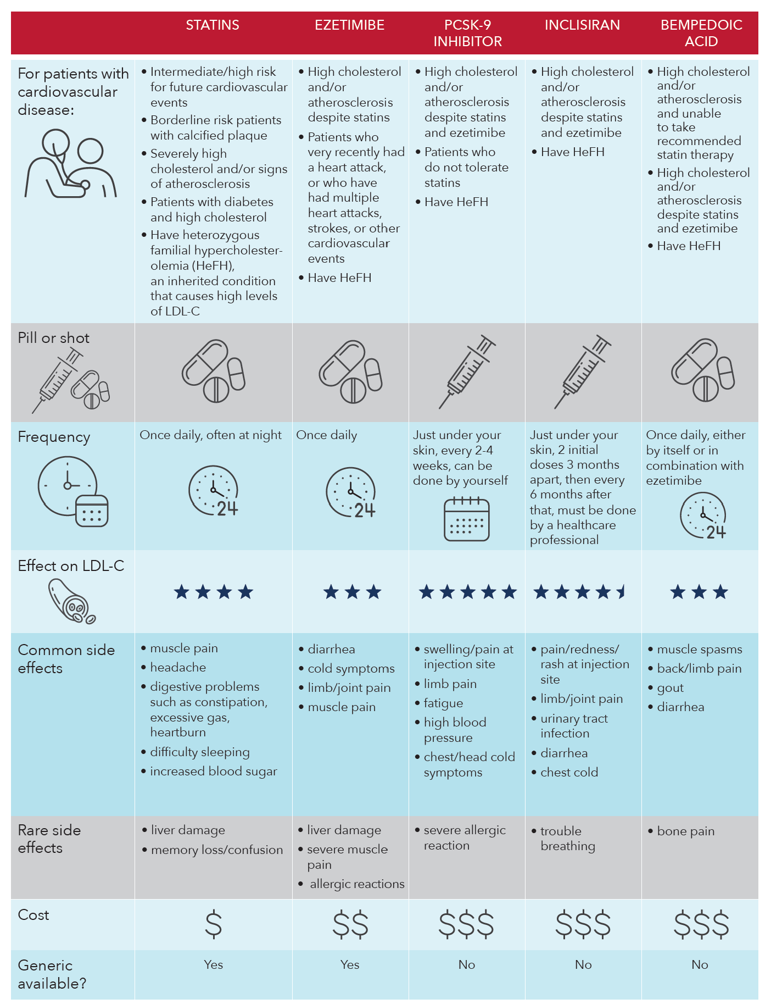
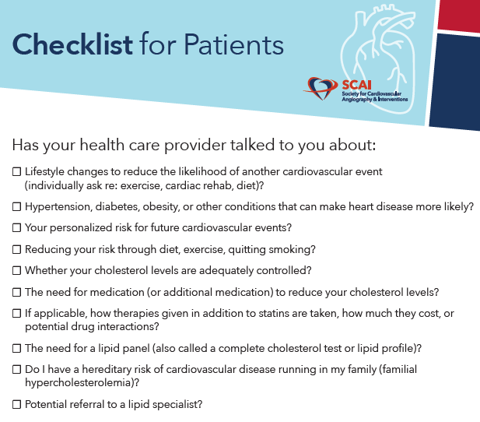
Clinician-Patient Discussion

Slide 22
Clinician-Patient Discussion

Slide 23
PCSK9i Prior Authorization and Denial Appeal
Prior authorization (PA)s require that healthcare practitioners provide and document the following data deemed necessary for medication approval
Most recent lipid panel
LDL is not at goal on maximally tolerated statin therapy and /or on ezetimibe
History of statin intolerance
A template PA form (attached) may serve as a universal guidance for review and application by payers
If authorization is denied, the appeals process enables clinicians to petition for a change in an insurance provider's decision regarding a prescribed therapeutic
An appeals template letter (attached) provides guidance to clinicians and payers to improve appeal success and patient access to prescribed therapy
Baum SJ, et al. Clin Cardiol. 2017 Apr;40(4):243-254.

Slide 24
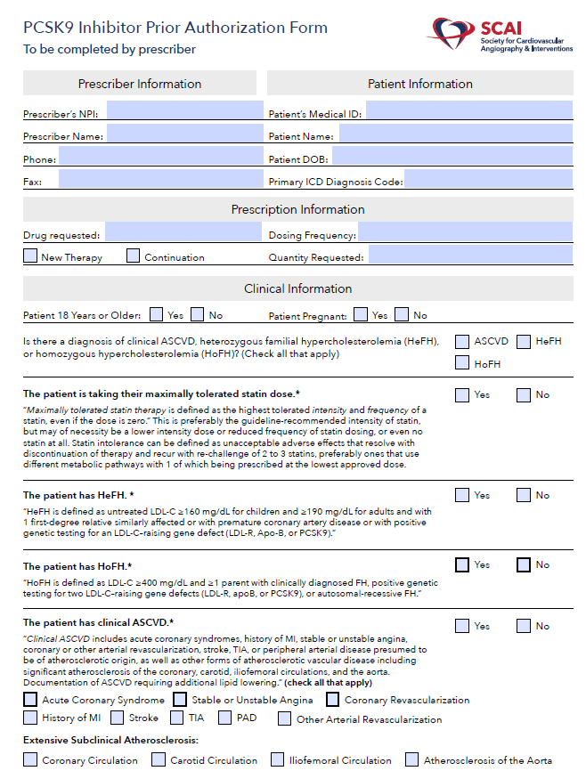
PCSK9i Prior Authorization Template
Baum SJ, et al. Clin Cardiol. 2017 Apr;40(4):243-254.
Notes:
Baum SJ, et al. PCSK9 inhibitor access barriers-issues and recommendations: Improving the access process for patients, clinicians and payers. Clin Cardiol. 2017 Apr;40(4):243-254. doi: 10.1002/clc.22713.

Slide 25
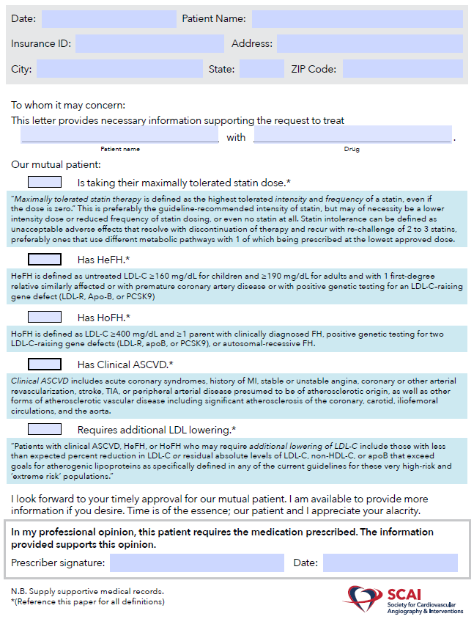
PCSK9i Denial Appeal Template
Baum SJ, et al. Clin Cardiol. 2017 Apr;40(4):243-254.

Slide 26
Facilitating Patient Access to PCSK9i
Satisfy Indications for Use - Document all clinically relevant information for payer requirements. Use a “PCSK9 Inhibitor Prior Authorization Form”
Start the Patient on Samples if available.
If Denied, Appeal. Use the Single-Page Appeal Form.
Act on the Decision of the Peer-to-Peer Consult
Engage the Patient
Meanwhile, Keep the Patient on Samples based on availability
If Appeal Is Denied, Request a Peer-to-Peer
Keep Fighting for Your Patient
Deploy Social Media - Ask the patient to post comments on Twitter or Facebook about the denial of the prescription, and tag the payer, appropriate legislators and other organizations, such as the ASPC and FH Foundation, so that the problem is noticed by decision makers.
Don’t Give Up! Always encourage behaviors and therapeutic lifestyle changes that will help lower LDL while continuing to appeal.
Baum SJ, et al. Clin Cardiol. 2017 Apr;40(4):243-254.
Notes:
Adapted from Baum SJ, et al. PCSK9 inhibitor access barriers-issues and recommendations: Improving the access process for patients, clinicians and payers. Clin Cardiol. 2017 Apr;40(4):243-254. doi: 10.1002/clc.22713.

Slide 27
Patient Support Program(s) for PCSK9i
RepathaReady Patient Resources Program [Evolocumab]
MyPraluent Patient Assistance Program [Alirocumab]
Leqvio Care Program [Inclisiran]

Slide 28
Fenofibrate
Fenofibrate may be added for the treatment of hypertriglyceridemia if other measures fail including:
lifestyle modifications (obesity and metabolic syndrome)
Management of other secondary factors (diabetes mellitus, chronic liver and kidney diseases, and hypothyroidism)
Omega-3 fatty acids
Fenofibrate is preferred over gemfibrozil when combined with a statin, given the lower risk of severe myopathy
Fenofibrate does not reduce cardiovascular mortality and has a modest effect on cardiovascular events reduction in patients receiving statins
Grundy et al. Circulation. 2019 Jun 18;139(25):e1046-e1081
Keech et al. Lancet. 2005 Nov 26;366(9500):1849-61

